Slide 1
Remember those semi-permament synoptic systems? These two drive the Walker Circulation
Nauru Low
Nauru Low
Chilean High
Chilean High
Upwelling water
https://i.gifer.com/Rcep.gif
The winds offshore from Ecuador pull up deep, nutrient-filled colder water, good for fishing
Notes:
Currently weak La Nina, with an ~75% chance of transitioning to neutral in the spring (NOAA, 2026)

Slide 2
What if the Walker pattern GETS STRONGER? (La Niña conditions)
Nauru Low
Chilean High
Upwelling water
https://i.gifer.com/Rcep.gif
=> stronger winds off the coast of South America, more upwelling of cold deep water off the coast of Peru & Ecuador, surface waters are colder and have more nutrient (great for fishing)

Slide 3
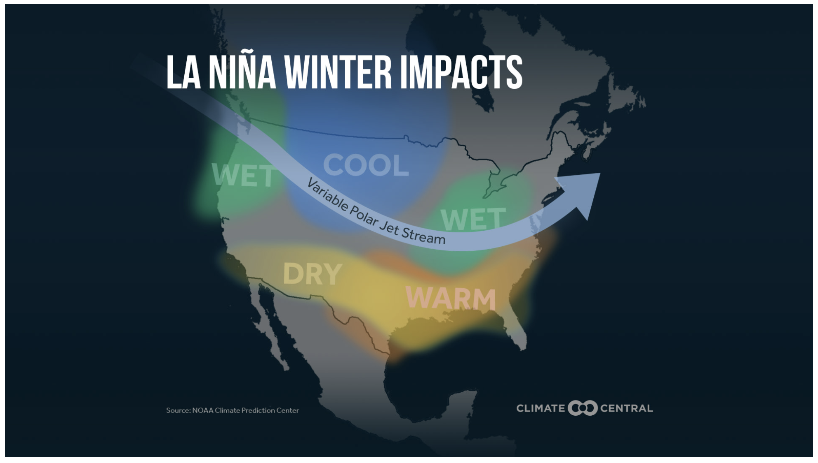
La Niña impacts in North America

Slide 4
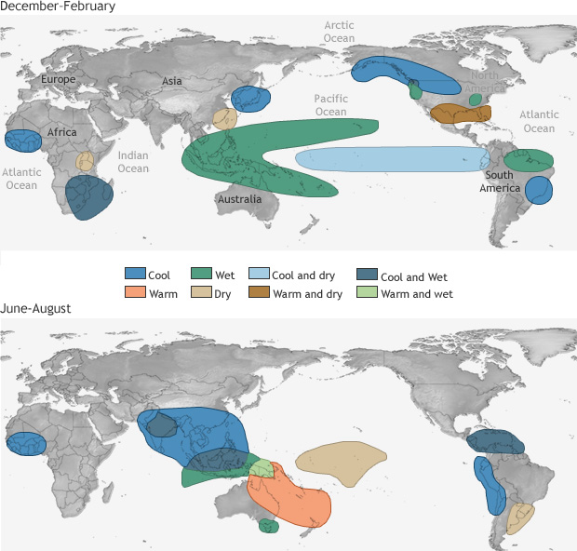
Global La Niña climate impacts
https://www.climate.gov/news-features/featured-images/global-impacts-el-ni%C3%B1o-and-la-ni%C3%B1a

Slide 5
What if the Walker pattern moves EAST? (El Niño)
Nauru Low ------>
Chilean High ------>
https://i.gifer.com/Rcep.gif

Slide 6
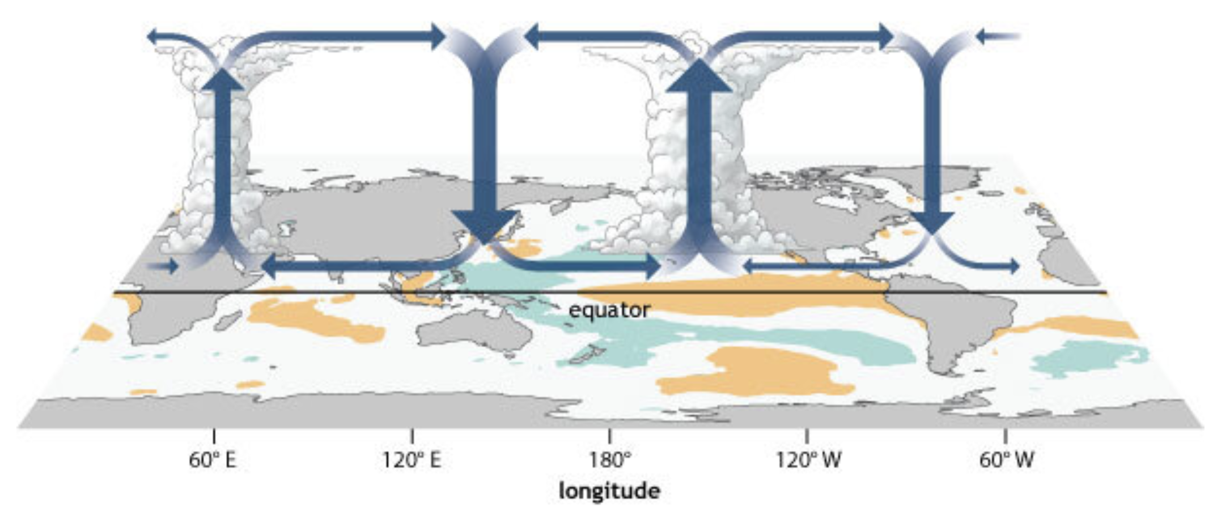
Eastward-shifted semipermanent synoptic systems during El Niño, and consequences
https://www.climate.gov/news-features/blogs/enso/walker-circulation-ensos-atmospheric-buddy
Ex-Nauru Low
Ex-Chilean High
Low
High
=> rainier in the central Pacific, less upwelling of that cold deep water off the coast of Peru & Ecuador, warmer and less nutritious surface waters (bad for fishing)

Slide 7
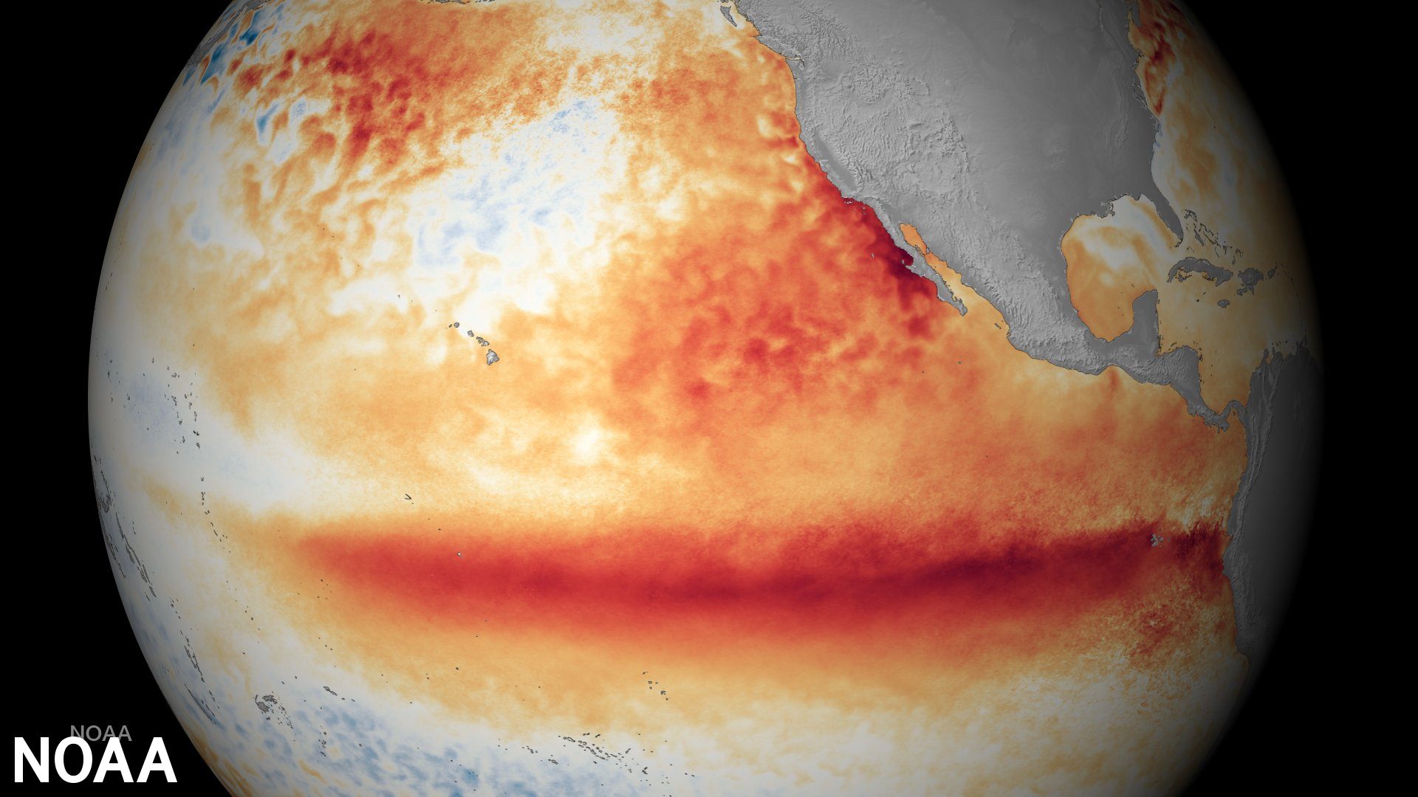
Temperature anomalies in the Pacific Ocean due to El Niño
https://www.noaa.gov/education/resource-collections/weather-atmosphere/el-nino

Slide 8
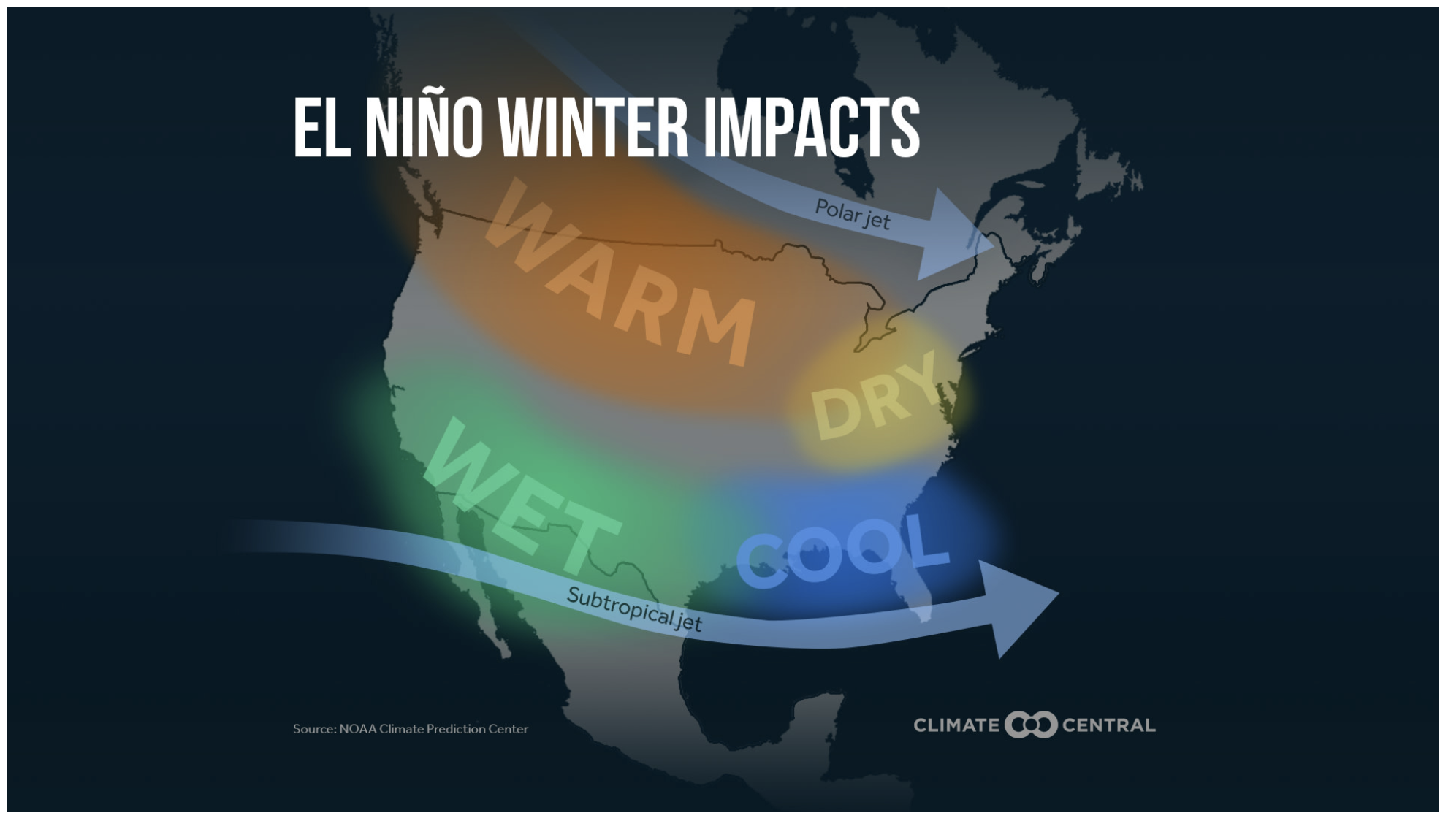
El Niño impacts in North America

Slide 9
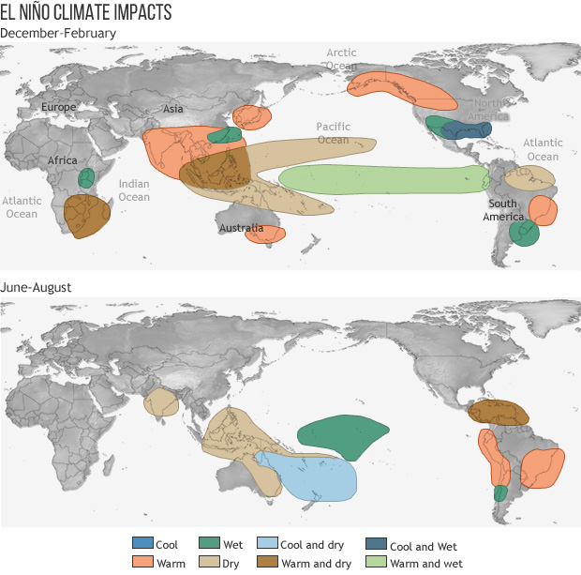
Global El Niño climate impacts

